Slide 1

AI Track for HackNUthon 6.0
Hack-NU-Thon 6.0: AI-Driven Fraud Detection and Secure Digital Identity Verification
EXCEED THE EXPECTED
Team Name: Ethereum
Parth Goswami
Samarth Patel
Harsh Pathak
DATE : 31st March,2025

Slide 2

Problem Statement & Proposed Solution
PROBLEM STATEMENT
AI Based
Financial Fraud Detection System
Design a system for banks that utilizes multiple AI agents to monitor and analyze transactions in real time, flagging suspicious patterns indicative of fraud.
The system should efficiently detect anomalies, provide contextual insights, and generate actionable alerts while ensuring compliance with financial regulations.
Proposed Solution
AI-powered fraud detection and secure identity verification
Biometric authentication (face recognition, fingerprints)
Blockchain-based digital IDs for secure access
LLM model for real-time fraud detection
Compliance with KYC/AML standards
Real-time alerts for suspicious activities

Slide 3
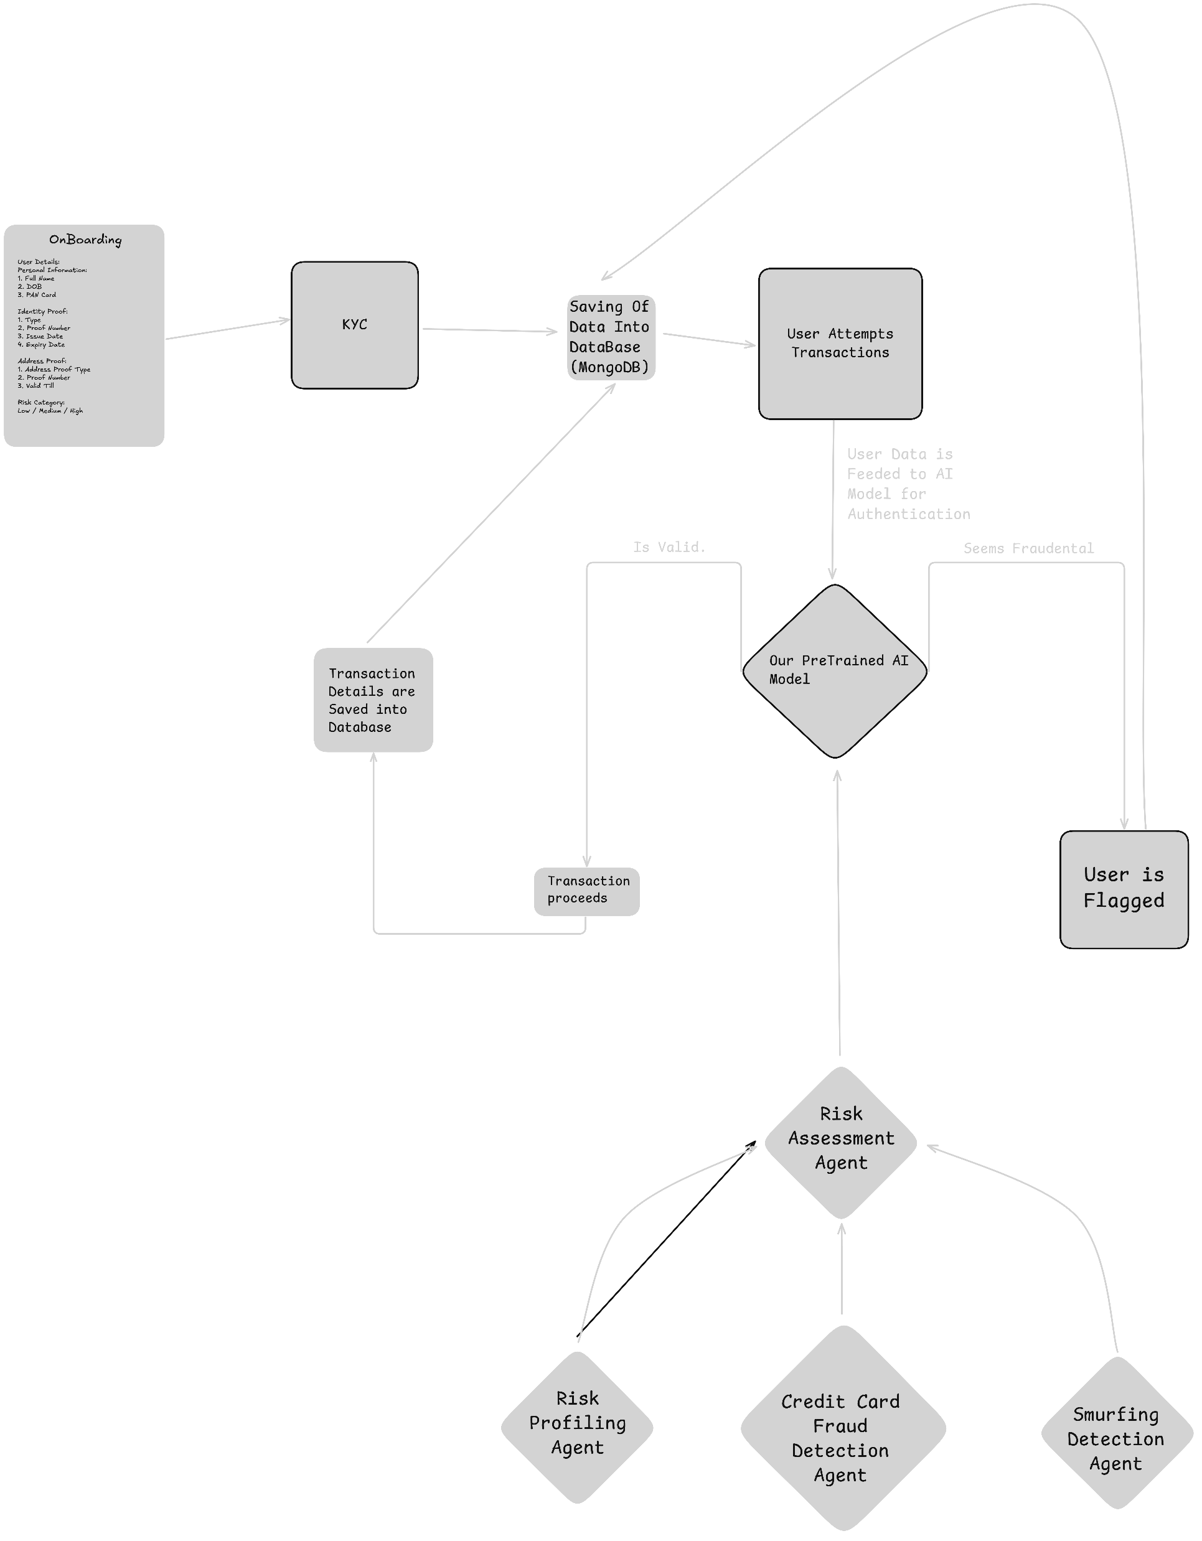





System Architecture Overview
Tech Stack
Python (ML), ReactJS (Frontend), Blockchain API, MongoDB
Key Modules:
Identity Verification (Blockchain), Fraud Detection (Anomaly detection in Credit Cards, Smurfing Detection, Risk Profiling), Compliance (KYC)
Scalability & Security:
Cloud integration, Data encryption, Real-time monitoring
Considerations
Scalability & Security.

Slide 4

Dataset Information
Dataset Size: 70,000 transactions
Number of Features: 25 columns
Purpose: Fraud detection in financial transactions
Key Columns:
Transaction Details: trans_date_trans_time, cardNum, merchant, category, Amount
User Details: first, last, gender, street, city, state, zip, lat, long
Demographics: city_pop, job, dob
Transaction Identifiers: transactionId, unix_time
Merchant Location: merch_lat, merch_long
Fraud Label: is_fraud (0 = Legitimate, 1 = Fraudulent)

Slide 5
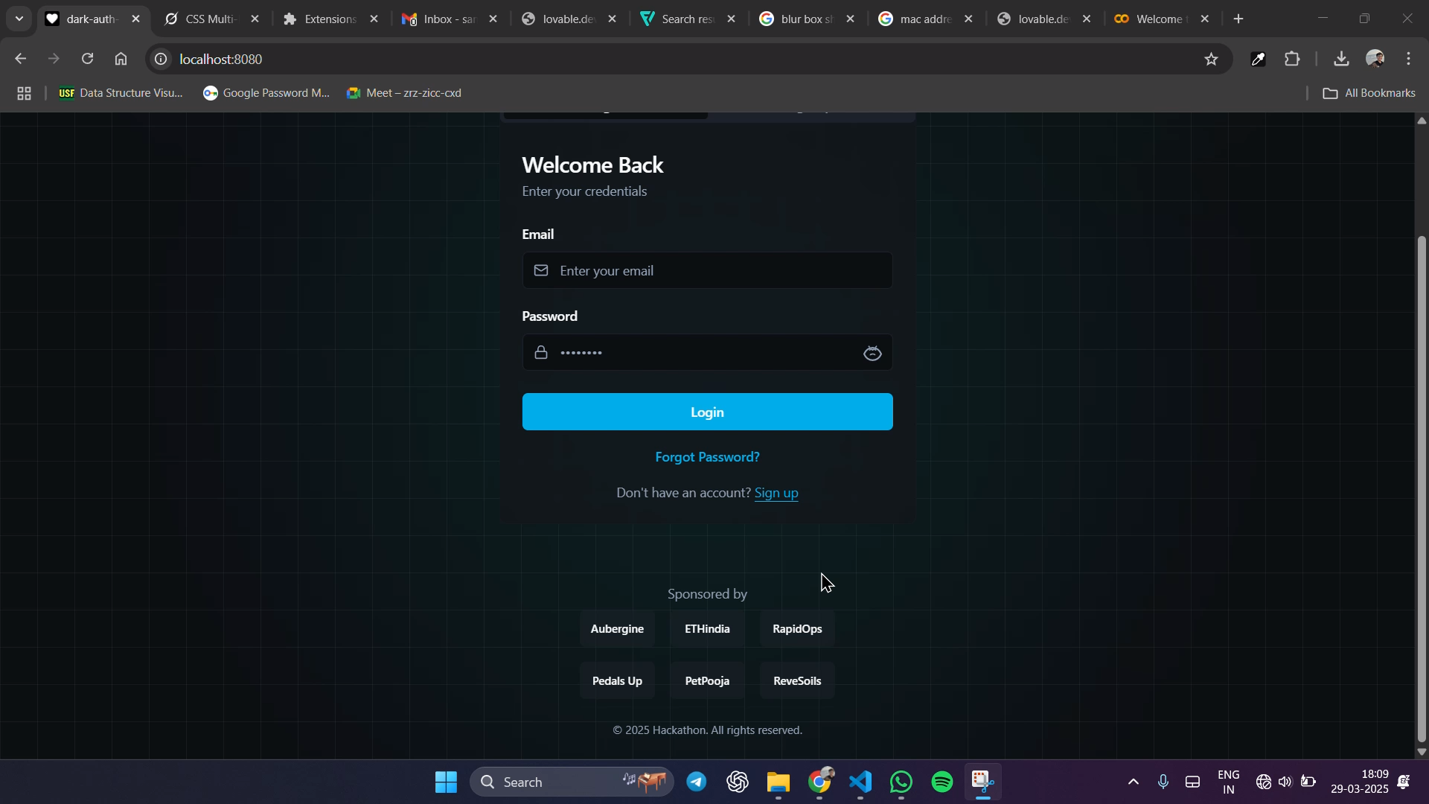

Prototype

Slide 6


Team Contributions & Summary
Project Impact:
Reduces financial loss due to fraud.
Strengthens user trust through secure authentication.
Simplifies compliance with KYC regulations.
Individual Contributions:
Harsh – Blockchain & Full Stack Developer: Secure digital identity implementation
Samarth - UI/UX Designer & Frontend Developer: User journey and interface design
Parth - Developer: Backend
Real-World Use Cases:
Banks and financial institutions(NBFIs) for fraud detection
Regulatory authorities for monitoring compliance
Insurance firms for claim verification

Slide 7

References & Resources
External Sources
Research papers on AI-driven fraud detection.
Datasets From Kaggle
APIs Used
Our Pre-Trained Model’s API
Database API calls for showing the user data in Admin Panel
Datasets
Dataset is made by using different datasets available in Kaggle and
We also used synthetic data
https://www.kaggle.com/competitions/ieee-fraud-detection/data
https://www.kaggle.com/datasets/kartik2112/fraud-detection
https://www.kaggle.com/datasets/berkanoztas/synthetic-transaction-monitoring-dataset-aml
Kaggle
ResearchGate.net
reproducible machine learning for credit card fraud detection practical handbook
Research

Slide 8
Thank You.

